Slide 1
Introduction To Compiler
Course Code: CSC 3220
Course Title: Compiler Design
Dept. of Computer Science
Faculty of Science and Technology
Lecturer No: | 3 | Week No: | 3 | Semester: | Summer23-24
Lecturer: | Nazia Alfaz, nazia.alfaz@aiub.edu, Room: D0201B

Slide 2
Lecture Outline
Symbol Table Management
Error Handler

Slide 3
Symbol Table
A symbol table is a data structure used in compiler design to store and manage information about various identifiers (variables, functions, classes, etc.) used in a program's source code. It helps the compiler to quickly look up information about these identifiers during the compilation process, such as their types, scope, and memory locations.
When writing code, you don't want to wade through a sea of variables and functions, trying to remember which is which. Instead, let the symbol table keep track of everything for you.
Several data structures can be used to implement symbol tables, such as hash tables, binary search trees etc.
Symbol table is used by both analysis and synthesis phases of a compiler

Slide 4
How does it work?
Imagine you're working on a compiler, and you come across a variable declaration, like int x;. The compiler needs to remember that x is an integer, and it'll need some space in memory to store its value. The symbol table steps in, acting like a librarian, keeping track of x, its type, and eventually, its memory location.
Later, when the compiler encounters a statement like x = 42;, it can refer to the symbol table, verify that x exists and is an integer, and then generate the appropriate code to store 42 at x's memory location.

Slide 5
Symbol Table Management
Managing a symbol table involves inserting, searching, and deleting entries. Let's dive into each of these operations and their importance.
Inserting Entries
When the compiler encounters a new identifier, it needs to be added to the symbol table. This process involves creating a new entry with the identifier's name, type, scope, and any other relevant information. The insertion process may also involve checking for duplicate identifiers within the same scope and throwing an error if one is found.
Searching Entries
When the compiler encounters an identifier in an expression or statement, it must look it up in the symbol table. Searching involves finding the relevant entry for the identifier based on its name and scope. For example, when processing a statement like y = x + 1;, the compiler searches for x in the symbol table to determine its type and memory location.
Deleting Entries
As the compiler processes the program, it may enter and exit various scopes. When exiting a scope, the entries associated with that scope should be removed from the symbol table. This cleanup process prevents memory leaks and ensures that identifiers from different scopes don't conflict.

Slide 6
Importance of Symbol Table
Symbol table management is vital in compiler design for several reasons:
It allows the compiler to efficiently store and retrieve information about the identifiers used in the source code.
It helps in ensuring that identifiers are used correctly, with proper scoping rules and type checking.
It enables the compiler to generate accurate and efficient machine code by providing information about the memory locations of variables and other identifiers.
It aids in producing meaningful error messages and debugging information for developers when issues arise in the code

Slide 7
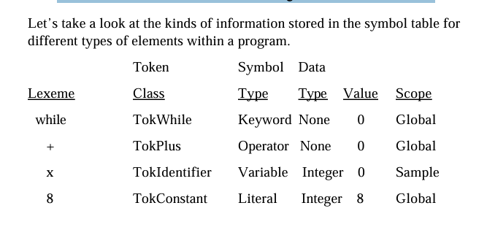
Data stored in the Symbol Table

Slide 8
Error Handling in Compiler Design
The tasks of the Error Handling process are to detect each error, report it to the user, and then make some recovery strategy and implement them to handle the error. During this whole process processing time of the program should not be slow.
Functions of Error Handler:
Error Detection
Error Report
Error Recovery

